Slide 1
Upgrade of the Barrier Bucket LLRF system for High-Intensity, Low-Loss Multi-Turn Extraction at the CERN PS
T. Gavric, B. Woolley, H. Damerau, Y. Brischetto, M. Vadai
15th October 2025

Slide 2
Overview
Introduction to CERN PS
Introduction and motivation behind MTE
Previous work
Synchronization scheme
New features
Exotic bunch shapes
Future work
10/15/2025

Slide 3
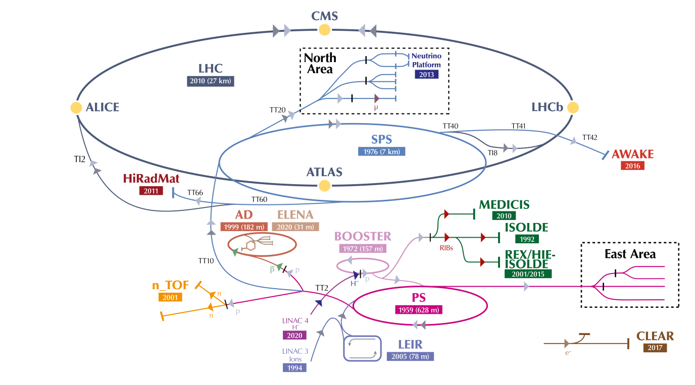
CERN Proton Synchrotron (CPS or PS)
Oldest operating machine
First multiplexed injector in the complex
Responsible for most RF gymnastics
Accelerates through relativistic transition

Slide 4
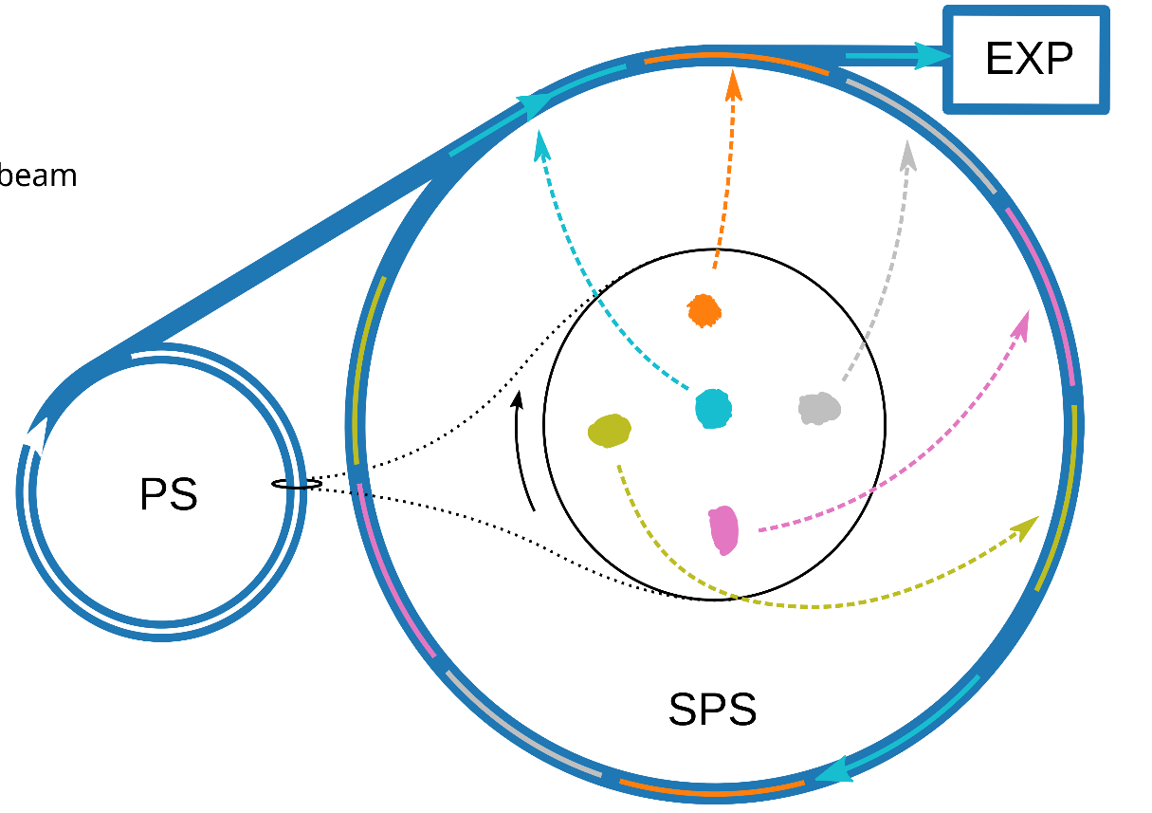

Introduction and motivation behind MTE
Mitigate PS extraction losses during 5 turn extraction of coasting beam
Pulsed RF: barrier-bucket for longitudinal kicker gap
Less losses with
PS-SPS transfer of fixed-target beam (SFTPRO)
All high-intensity fast- extracted beams without dummy septum
M. Vadai, Barrier-bucket multi-turn extraction reducing losses at PS-SPS transfer, https://indico.cern.ch/event/1254574/
2023: First full year of operation → major success

Slide 5
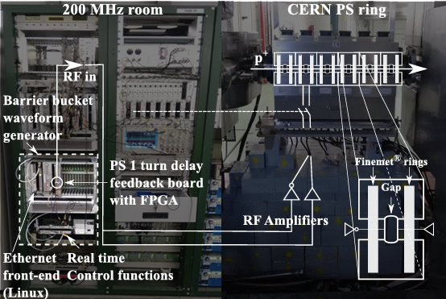
Previous work
Barrier-bucket MTE scheme significantly reduces beam loss in PS extraction region
Non-PPM (non-multiplexed) barrier waveform
Lacked flexibility
2 consolidation boards
h16 measurement
h1 measurement
10/15/2025

Slide 6
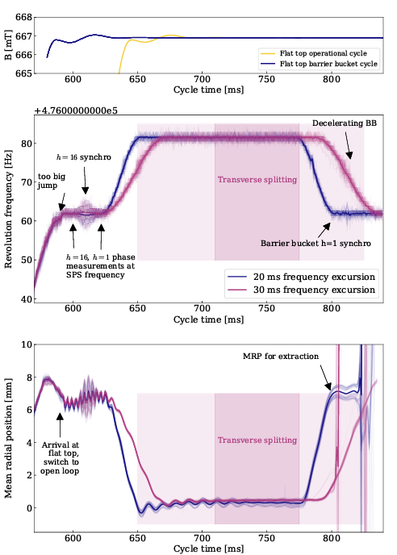
Synchronization scheme
Conventional synchronization not possible
RF voltage of the wide-band cavity generating the BB would be too low for a conventional synchronization
Synchronization concept in use:
Synchronizing in h16 using feed-forward cogging with the main 10 MHz RF system
Lower accuracy than typical closed loop synchronization, but sufficient for barrier buckets
Synchronization in h1: phase measurement and communicating phase information within the cycle to set the correct barrier position for extraction
10/15/2025
Notes:
590-600 Loops off,ℎ16 phasemeasurement 600 ℎ1 phase measurement 600-620 Cogging 620-650 Radial steering to central orbit 650-770 Constant offset for MTE 770-800 Radial steering to extraction orbit 800-815 Hand-over ℎ16 to barrier bucket 800-815 Debunching 835 Extraction

Slide 7
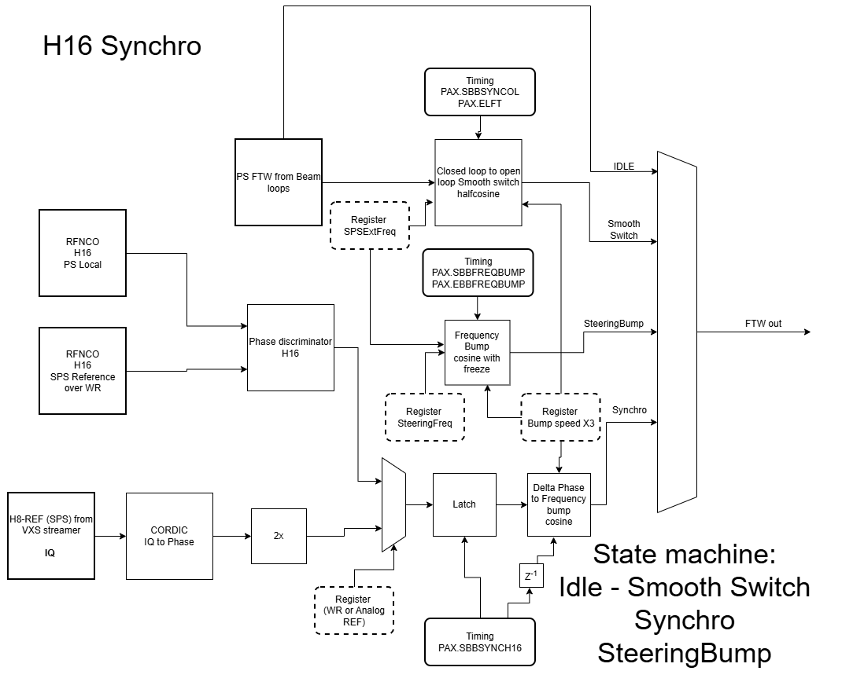
H16 synchronization
Synchronization to the nearest bucket
Measure h = 16 phase of bunches in PS with respect to SPS
Frequency bump to correct beam phase → cogging
Part of the new PS beam control firmware
10/15/2025
Notes:
590-600 Loops off,ℎ16 phasemeasurement 600 ℎ1 phase measurement 600-620 Cogging 620-650 Radial steering to central orbit 650-770 Constant offset for MTE 770-800 Radial steering to extraction orbit 800-815 Hand-over ℎ16 to barrier bucket 800-815 Debunching 835 Extraction

Slide 8
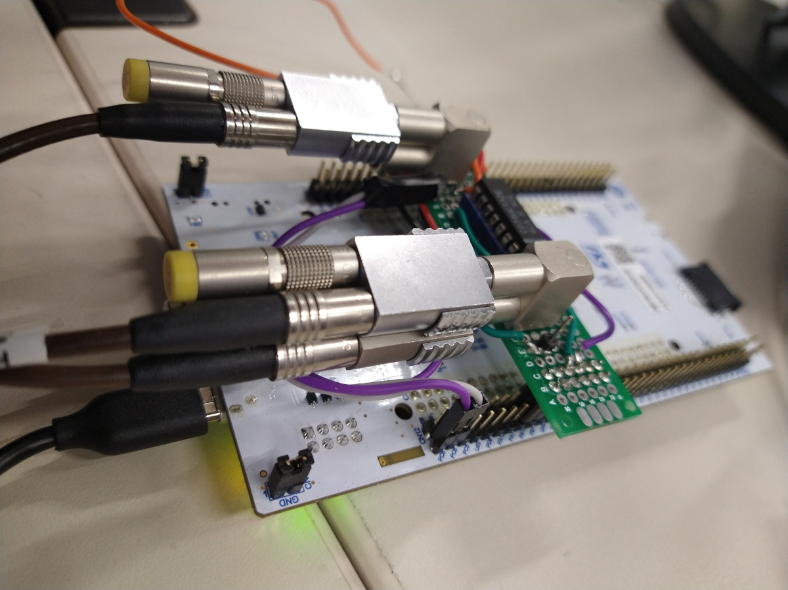
Change in h1 measurement
PS h=1 RF
h=1
controller
h=1 controller measures the phase w.r.t. SPS and sends it real-time via C programs on front-ends to the barrier bucket drive
SPS h=1 RF
Network
φ_{h1} mod h16
BB
drive
To wideband
cavity
New Finemet cavity controller
Non-standardized hardware removed
Enables remote intervention
10/15/2025
Notes:
- Hardware only used for synchronization.
- Hand-made electronics, conforms to no rack standard.
- Power and comms: FEC via USB.

Slide 9
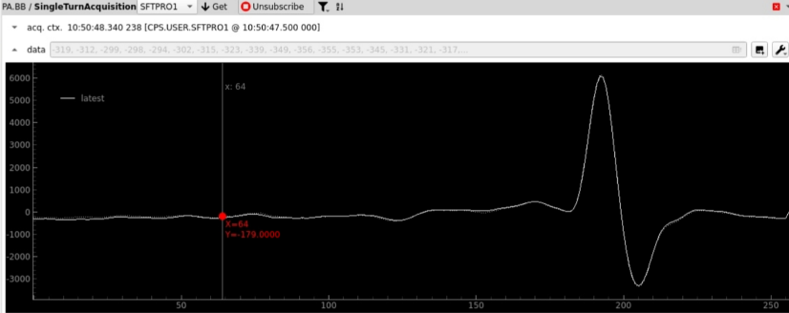
New features (1)
Full control of RF drive voltage
PPM/Multiplexed
Arbitrary waveform
15-bit waveform memory
Acquisition of gap voltage
Single turn
Hard trigger (from General machine timing through backplane)
OR Software trigger
Arbitrary gain function of the waveform
FGC: Internal function generator – new preferred option
CVORB – external function generator – separate HW
10/15/2025

Slide 10
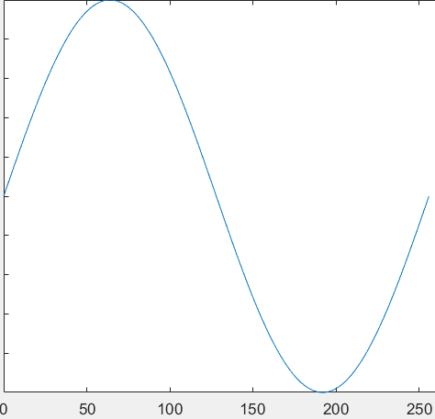
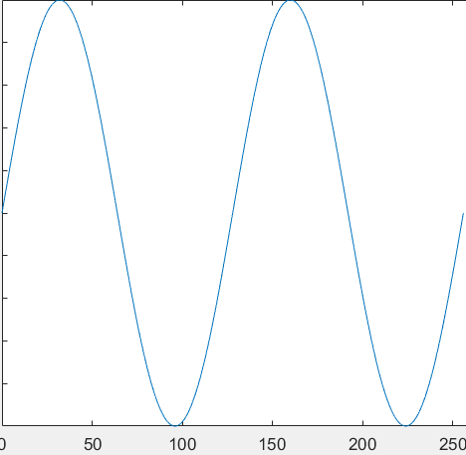
New features (2)
New extraction synchro for PS: h1 measurement w.r.t. SPS derived h1
Updates BB azimuth during the cycle (C620 ms)
SPS h1 phase measurement performed on the cavity controller using beam synchronous NCO
Added internal acquisition channels:
10kHz sample rate during whole cycle
Voltage output gain function
h1 phase measurement – between SPS derived h1 and PS h1
Accordion sweep of the waveform
Time in which sweep happens can be set
Used for smooth batch compression – interesting for possible ion chain upgrade
10/15/2025

Slide 11
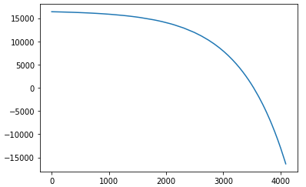
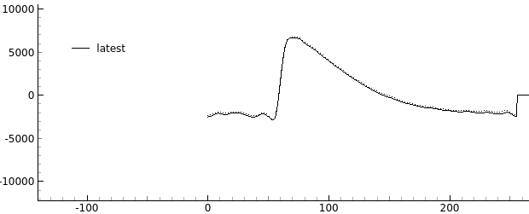
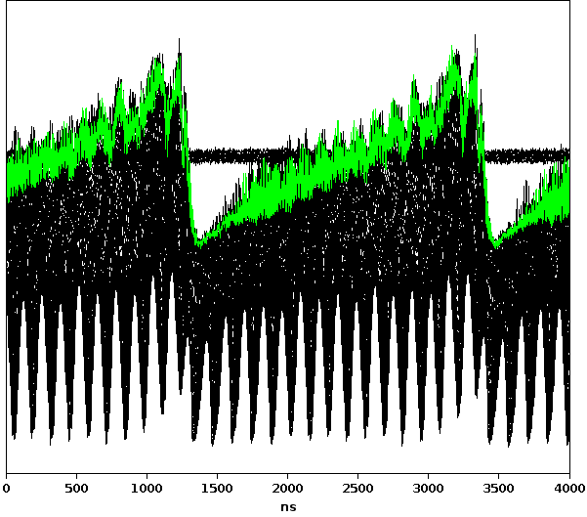
Exotic bunch shapes
New Finemet controller → Full control of RF voltage function during a turn
Finemet cavity gap voltage
DAC bins
Drive function (1 turn)
Clock samples (h₂₅₆)
Future applications of PS wide-band cavity
Transient beam loading compensation

Slide 12


Future work
Phase loop
B
polinomial
harmonic (F)
Noise
Cutoff F
HPF
IQ Memap
Cutoff
Kp, Ki Phase
window
?
offset
synchro
Deploy new firmware during commissioning period
Test BB IP as a part of new digital PS beam control
Additional updates to enable further beam manipulations
Stable phase (F)
frequency (R)
loop (F)
detection
MemMap
H
synchro
?
Deserializer
transition
Sushi
CORDIC
H
armonic
Selected H
Phase
PI
train
and
selection
dPhase
error
HPF
controller
(QSFP)
Memap
H
a & Hb
dPhase
Phase loop
Beam and cav phase offset (F)
Sum masking (F)
Rpos
IQ
Computation
R loop harmonic (F)
Kp, Ki, R steering (F)
Start (T)
Barrier
Ha
(cordic)
Bucket
Rpos
IQ
Computation
Rpos
Ha
Harmonic
PI Controller
Transition
Hb
(cordic)
Rpos
Hb
selection
Selector (T)
Radial loop
Enable
WR Core
SFP
Corrections
23
-
bit
H8
Phase
Kp, Ki (F)
FMC
parallel
H9
-
Ref
offsets
Fine synchro phase
PI controller
Synchro
-
Ref
and
loop
H84
H
1
-
-
Ref
harmonic
Coarse synchro phase
correction
Ref
PI controller
F
function
Barrier Bucket
selection
K
,
playback
AVC
inhibit
Synchro phase offset,
Threshold
Kp, Ki (F)
dR
phase, radial, synchro
?
loop
harmonic (R)
detection
Synchro
loop
Function
H
prog
R loop
st
art/stop
Start (T)
generator
phase, radial
Timing
st
art/stop
?
stable
S loop
st
art/stop
GFSTRIM
Transition
start
F measured
Sum masking
Threshold
SFP
WR
Btrain
Btrain
Frev
+
start
Core
Receiver
to Frev
GFSTRIM
F sim
F function
F playback
Block diagram of the new PS beam control firmware
Credits to Francisco Javier Diaz Ferreira
10/15/2025

Slide 13
Acknowledgements
CERN SY-RF-LL
B. Woolley
CERN SY-RF-CS (LLRF Software)
Y. Brischetto
CERN SY-RF-BR (Beams & RF studies)
H. Damerau
10/15/2025

Slide 14
Questions ?
10/15/2025
T. Gavric | Upgrade of the Barrier Bucket LLRF system for High-Intensity, Low-Loss Multi-Turn Extraction at the CERN PS

